Slide 1
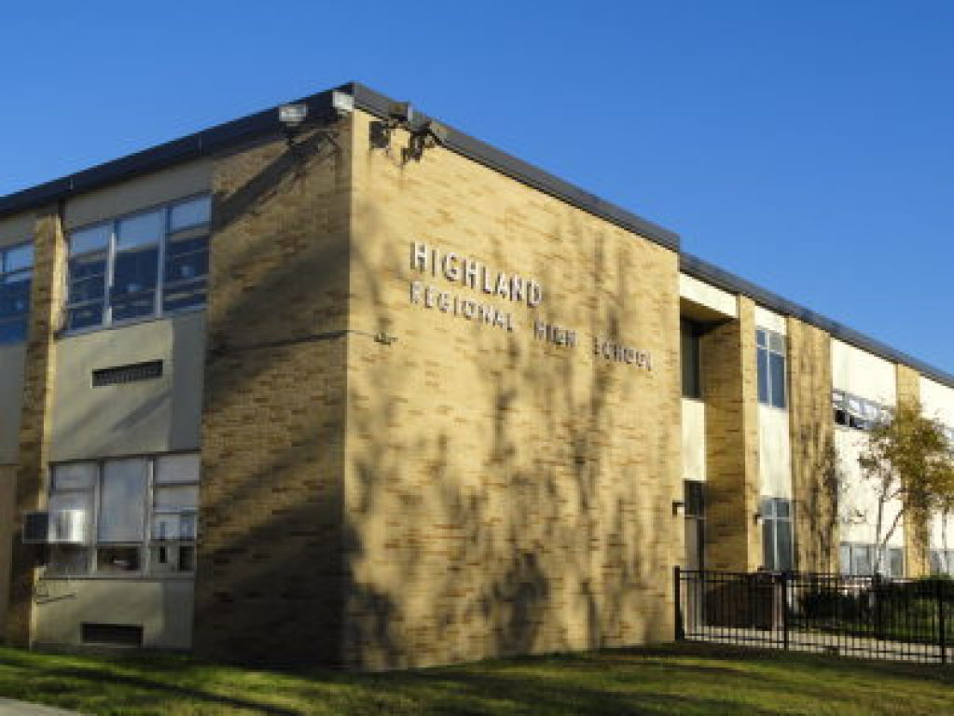
Welcome to 8th Grade Orientation
Class of 2022!
"Where Inspiring Excellence is our Standard and
Student Achievement is the Result"

Slide 2
Highland Administration Home of the Tartans
Ms. Lisa Owen | Principal
Ms. Christina Collazo | VP - Grade 9
Mr. Michael Jones | VP - Grade 10
Mr. Ron Strauss | VP - Grade 11
Mr. Daniel Beaver | VP - Grade 12
Mr. Art Alessandroni | Director of School Counseling

Slide 3
Air Force Junior Reserve Officer Training (AFJROTC)
Master Sergeant Christopher Miller
served in the Air Force 20 years
JROTC instructor at Vineland HS for the past 4 years
B.S in Business Administration for American Intercontinental University
M.S in Administrative Justice (Homeland Security) form Wilmington University
Major Robert Simpson
served in the Air Force 20 years
started the JROTC program at Vineland HS and instructor there for the past 8 years
B.A in History from Rutgers University
M.S in History from University of Central Missouri

Slide 4
Air Force Junior Reserve Officer Training (AFJROTC)
*Air Force Junior Reserve Officer Training Corps (AFJROTC) is a five-credit Practical Arts Course offered to all high school students in our District
*This program is designed to teach students in grades 9–12 the value of citizenship, leadership, service to the community, personal responsibility, and a sense of accomplishment, while instilling in them self-esteem, teamwork, and self-discipline.
*The program of instruction is based on a systematic progression of learning designed for the student’s development starting at the freshman year and progressing through the senior year.
*Major units of study include: U.S. Citizenship, Leadership, Aviation History, Wellness, Fitness, and AFJROTC History.

Slide 5
Highland Counseling Office (p) 856-227-4100 x4036 (f) 856-227-8422
Art Alessandroni Lisa Casares Maryann Miller | Counseling Director Counseling Secretary Counseling Secretary | aalessandroni@bhprsd.org lcasares@bhprsd.org mmiller@bhprsd.org | Extension X 4036 X 4037
Alicia Kohn | (A – Coh) | akohn@bhprsd.org | X 4042
DJ Gore | (Coi – Gla) & BD | dgore@bhprsd.org | X 4041
Tiffany Strauss | (Glb – Lan) & MD | tstrauss@bhprsd.org | X 4040
Chris Bennett | (Lao – Oc) | cbennett@bhprsd.org | X 4038
Ashley Balzer | (Od – She) | abalzer@bhprsd.org | X 4039
Sarah Smith | (Shf – Z) | ssmith@bhprsd.org | X 4030
Lauren McElroy | Career Exploration Counselor | lmcelroy@bhprsd.org | X4114
Jan Vizoco | Student Assistance Coordinator | jvizoco@bhprsd.org | X 4011

Slide 6
Child Study Team (CST) (856)227-4100 x 4047
Dave Cappuccio Erika Silich Jessica Caffrey | Director of... Supervisor of… Supervisor/ … | Special Services Special Education Behavior Analyst | extension
Lori Massi | CST secretary | lmassi@bhprsd.org | X 4047
Joe DeVecchis | (A – I) & PAUSE | jdevecchis@bhprsd.org | X4048
Erin Ross-Bailey | (J – R) & BD | ebailey@bhprsd.org | X 4063
Lindsay Vargas | (Out of District) | lmcdonald@bhprsd.org | X 4404
Jackie Kulinski | (S – Z) & MD program | jkulinski@bhprsd.org | X 4049
Student schedules will be determined by the case manager - in consultation with the school counselor - in accordance with the Individual Educational Plan (IEP)

Slide 7
Returning Forms
Course Selection Form and Demographic TONIGHT!
If your child will NOT attend Highland HS, we still need you to return the form, indicating where the student WILL attend.
Students selected eight (8) courses.
The Program of Studies is available on our district and school websites at www.bhprsd.org/highland under Parents & Students tab.
Students who are NOT Proficient on the Math or Language Arts section(s) of the 2018 PARCC may have additional Math and/or English courses added to their schedule. These courses would replace their selected elective(s) and/or World Language. State testing results typically become available in August. Students will be notified by mail if changes should occur.

Slide 8
PARCC Testing - Summer
Summer Option:
Passed Alg I but not PARCC
“Learning Module” ONLY (740-749)
Take PARCC in summer window
Level 3
Math elective (1.25 credits) July 16-30
Take PARCC in summer window

Slide 9
PARCC REMINDERS
class of 2022
Starting with the Class of 2022, students will need to meet the high school graduation assessment requirements by passing PARCC ELA Grade 10 and PARCC Algebra I. If students are unable to pass one or both of those assessments, they will be able to access the portfolio appeals process to meet the assessment requirements, but only if they take all PARCC assessments associated with the high-school level courses for which they were eligible* (see chart below).

Slide 10
Class of ‘22 and beyond
ENGLISH LANGUAGE ARTS (ELA)
PARCC ELA Grade 10 (must take and pass)
------------------------------------------------------------------
If passing score is not met on PARCC ELA Grade 10,
then the student must have taken
PARCC ELA Grade 9
and
PARCC ELA Grade 10
and
PARCC ELA Grade 11
before they can
---------------------------------------------------
Meet the criteria of the NJDOE Portfolio Appeal
MATHEMATICS
PARCC ALGEBRA I (must take and pass)
-------------------------------------------------------------------
If passing score is not met on PARCC Algebra I,
then the student must have taken
PARCC ALGEBRA I
and
PARCC GEOMETRY
and
PARCC ALGEBRA II
before they can
----------------------------------------------------
Meet the criteria of the NJDOE Portfolio Appeal

Slide 11
Scheduling Information
Honors selections will be noted on the course selection form. These recommendations are made by District Supervisors, not MS teachers or HS counselors.
What is used to determine your child’s courses?
Middle School REPORT CARDS
Middle School State Assessments
Current course placements
IQ Scores
Initial course recommendations may change due to changes in students FGs and/or PARCC results

Slide 12
A “typical” day
Highland Regional runs on a 4-day rotation (A-D days) Each day, six (6) of the students eight (8) classes will meet All students will have an OPEN lunch & learn for 45 minutes, separating the three courses in the AM and PM sessions
Enter school = 7:15 am
class 1 begins = 7:25 AM w/ morning announcements
Students have 4 minutes in between periods
Each instructional bell = 55 minutes
School ends = 2:01 pm

Slide 13
Bell Schedule
Period | Time In | Time Out | Minutes | A Day | B Day | C Day | D Day
Announcements 1st Bell | 7:25 AM 7:30 AM | 7:30 AM 8:25 AM | 5 minutes 55 | 1 | 4 | 3 | 2
2nd Bell | 8:29 AM | 9:24 AM | 55 | 2 | 1 | 4 | 3
3rd Bell | 9:28 AM | 10:23 AM | 55 | 3 | 2 | 1 | 4
4th Bell | 10:23 AM | 11:08 AM | 45 | Tartan Time | Tartan Time | Tartan Time | Tartan Time
5th Bell | 11:08 AM | 12:03 PM | 55 | 5 | 8 | 7 | 6
6th Bell | 12:07 PM | 1:02 PM | 55 | 6 | 5 | 8 | 7
7th Bell | 1:06 PM | 2:01 PM | 55 | 7 | 6 | 5 | 8
After School | 2:01 PM | 2:40 PM | After School
 |  |  |  | Not 4 or 8 | Not 3 or 7 | Not 2 or 6 | Not 1 or 5

Slide 14
Graduation Requirements (see pp. 12 in the POS)
Meet all NJ requirements for PARCC and other state assessments
Students MUST earn 130+ (beg. Class of 2017) credits of both required and elective courses
Successfully complete the following:
~ 4 years of English
~ 4 years of Health & Physical Education
~ 3 years of Mathematics – including Algebra I and Geometry or the content equivalent and a third year of math that builds on the concepts and skills of Algebra and Geometry
~ 3 years of Science – including at least five credits in laboratory biology/life science or the content equivalent and one additional laboratory/inquiry-based science course which shall include chemistry, environmental science, or physics
~ 2 years of US History and 1 year of World History – integration of civics, economics, geography and global content in all course offerings.
~ 1 Year of 21st Century Life and Careers, or Career Technical Education
~ 1 Year of Visual/Performing Arts
~ 1 Year of World Language
~ 1/2 year of Financial Literacy
~ 1/2 year of Career Education
Meet all provisions of District Attendance Policy #5200
*All years listed above are the minimum number of years required for graduation*

Slide 15
“Most” freshman have….
English (FY)
World History & Cultures (FY)
Mathematics (FY)
Science (FY)
Health/Physical Education (FY)
Freshman Seminar (FY)
World Language (FY) - if in English IA or Honors
Elective(s) - a min. of one (1) for most

Slide 16
Credit Requirements
Students in grades 9, 10, & 11 must carry
35 - 40 credits (7-8 courses) per year
Movement to Grade 10 > 30 Credits
Movement to Grade 11 > 65 Credits
Movement to Grade 12 > 90 Credits
------------------------------------------------------------------------------------
Graduation > 130 credits

Slide 17
Grading System
Numerical Average | Letter Grade | CP & A level “unweighted” | Honors Courses “weighted” | AP Courses “weighted”
93-100 | A | 4.00 | 5.00 | 5.00
90-92 | A- | 3.67 | 4.67 | 4.67
87-89 | B+ | 3.33 | 4.33 | 4.33
83-86 | B | 3.00 | 4.00 | 4.00
80-82 | B- | 2.67 | 3.67 | 3.67
77-79 | C+ | 2.33 | 3.33 | 3.33
73-76 | C | 2.00 | 3.00 | 3.00
70-72 | C- | 1.67 | 2.67 | 2.67
67-69 | D+ | 1.33 | 2.33 | 2.33
65-66 | D | 1.00 | 2.00 | 2.00
Below 65 | F | 0.00 | 0.00 | 0.00

Slide 18
Class Rank/GPA - (Val & Sal)
Grade 9 Honors selections are determined by District supervisors as per district guidelines
The maximum number of Honors classes a student can be recommended for in grades 9 and 10 is four (4) (English, Mathematics, Science and Social Studies).
In most cases, future valedictorians and salutatorians have had the maximum number of AP/Honors courses in all grades.
A fifth AP/Honors course should be considered both junior and senior years if becoming a valedictorian and/or salutatorian is a goal.
Ranking (in accordance with Board Policy #R2624)

Slide 19
Clubs & Activities
CLUBS/ADVISORS |  | ACTIVITIES/ADVISORS |  | ACTIVITIES/ADVISORS
ACADEMIC CHALLENGE MR. MOUSTAKIS |  | DANCE INC. MS. DAVIS |  | H.E.R.O. MS. BALZER
ART/ILLUSTRATIONS MS. N. SMEDILE |  | ENVIRONMENTAL CLUB MRS. DURANTE |  | HIGHLAND NEWS TO YOU MR. DENNISON
BAND DIRECTOR MR. TUMINIA |  | FALL PRODUCTION MS. BOECKLE |  | HISTORY CLUB MR. WONDERLIN
BIBLE STUDY MS. KOLODY |  | FILM PRODUCTION MR. KEYSER |  | ITALIAN CLUB MS. LASPADA
BUDDY CLUB MRS. LINANE & MR. DIMAULO |  | FRENCH CLUB MRS. MCGRATH |  | INTERACT MRS. LINANE
CHOIR/CHORALE MS. KOLODY |  | GAY/STRAIGHT ALLIANCE (GSA) MS. K. FOWLER |  | KEY CLUB MR. WINFIELD
 |  | GREEN TEAM MRS. DYL |  | MUSICAL PRODUCTION MRS. KRISCH / MS. KOLODY / MS. WIERSKI

Slide 20
Clubs & Activities
CLUBS/ADVISORS |  | ACTIVITIES/ADVISORS |  | ACTIVITIES/ADVISORS
NATIONAL HONOR SOCIETY MS. SMITH |  | SAT CLUB |  | TEEN PEP MS. PASQUARELLO/MRS. WILSON
ONE ACTS |  | SPANISH CLUB MRS. ZOLADZ |  | TRANSITION PROJECT MR. AJDERIAN, MR. J. SMITH
PEER MENTORS |  | SPRING MUSICAL |  | VOLLEYBALL CLUB
PHOTOGRAPHY CLUB |  | STAGE CREW |  | WORLD LANGUAGE CLUB
POETRY CLUB |  | STUDENT COUNCIL MRS. STRAUSS |  | WORLD OF DIFFERENCE MS. RIOS
RENAISSANCE CLUB MRS. LORING |  | STUDENT MENTORING MRS. MARKS |  | YEARBOOK PUBLICATIONS MS. BAEZ, MS. CLIFFORD, MRS. LORING
S.T.E.A.M. MR. CARVALHO |  | TECH SQUAD MR. CARVALHO

Slide 21
HHS Athletics Athletic Director: Mr. Frank Torcasio 856-227-4100 x4080
FALL SPORTS | WINTER SPORTS | SPRING SPORTS
FOOTBALL MR. LEARY | WRESTLING MR. PLEFKA | SOFTBALL MS. MINIX
FIELD HOCKEY MS. HANNAH | SWIMMING (COED) MR. GRATTON | BASEBALL MR. GORE
BOYS SOCCER MR. TOLOMEO | BOYS BASKETBALL MR. KUPERSMIT | GOLF (COED) MR. BENNETT
GIRLS SOCCER MS. RHEA | GIRLS BASKETBALL MR. SENFT | BOYS TRACK & FIELD MR. WAGNER
CHEERLEADING MRS. ARMSTRONG | CHEERLEADING MRS. ARMSTRONG | GIRLS TRACK & FIELD MRS. MARKS
GIRLS TENNIS MR. WONDERLIN | WINTER TRACK MR. AJDERIAN | BOYS TENNIS MR. WONDERLIN
BOYS/GIRLS CROSS COUNTRY MR. WAGNER/MR. KROWICKI |  | BOYS LACROSSE MR. BLACK
LIFE SKILLS SOCCER MRS. MODERSKI & MS. BRADLEY | LIFE SKILLS FLOOR HOCKEY MRS. MODERSKI & MS. BRADLEY | GIRLS LACROSSE MS. RHEA

Slide 22
ACADEMIC ELIGIBILITY
All incoming freshmen are academically eligible for the 1st semester, which includes BOTH the fall & winter sports seasons.
To be spring eligible, students must earn > 15 credits after semester one. All students must pass at least 30 credits by September to be eligible for the following fall & winter seasons.
All students must turn in a parent permission card as well as have a physical examination by either the school doctor or their family doctor.

Slide 23
Athletic Transition from 8th to 9th Grade Athletic Director: Mr. Frank Torcasio 856-227-4100 x4080
FAMILY ID:
All forms are to be completed on Family ID except for the Physical form and Health History form. The website is www.familyID.com Once you have a familyID login, your information will be there from one season to the next. All you have to do is sign in and update any information that may have changed.
*When done filling in all information, please make sure to hit the “green” submit button*

Slide 24
Athletic Transition from 8th to 9th Grade Athletic Director: Mr. Frank Torcasio 856-227-4100 x4080
PHYSICAL FORMS:
Can be found on our website as well as on the FamilyID website. They are good for 365 days
If the physical form expiration date is after the first official practice, they are still eligible.
A new physical must be completed ASAP and handed in to the nurse.
All physical packets need to be COMPLETED and turned into the NURSE by the following dates to ensure the ability to participate on the first day of practice. Any missing signatures or papers will be considered incomplete and could delay your ability to participate. NO EXCEPTIONS!
ALL physicals must be cleared by the District Doctor.
Parent-Student Athletic Handbook can be found in Family ID

Slide 25
Athletic Transition from 8th to 9th Grade Athletic Director: Mr. Frank Torcasio 856-227-4100 x4080
ImPact Testing:
Gives a “baseline” for Athletic Trainers and/or Doctors when a student-athlete sustains a concussion. This is done every two years.
Info @ impacttest.com
Take test @ impacttestonline.com/schools
--------------------------------------------------------------------------------------------------------------
Highland Customer ID Code: ADDB273F4E
Triton Customer ID Code: 44907883D4
Timber Creek Customer Code: 542D7DC4DA

Slide 26
Colleges, Careers, About Me
Naviance is a comprehensive, easy-to use-website that you and your parents can use to help in making decisions about courses, colleges, and careers. Naviance is accessible from any computer, inside and outside of school, with an internet connection
Just go to the Highland’s Home Page, click on the Counseling Tab, and then Naviance. All students are provided with a password in 9th grade. Both parents and students may access many of the features without a password by visiting as a guest.

Slide 27
class of 2022
You may join any or all class groups:
Remind will allow you to receive Counseling reminders throughout the year. Messages will come from Mr. Alessandroni, Director of School Counseling
What is Remind and why is it safe?
Remind is a one-way text messaging and email system so all personal information remains completely confidential. We will never see your phone number and you will not see ours. Visit www.remind.com to learn more.
-----------------------------------------------------------------------------------------------
To receive messages via text:
Text “@mralessan” to 81010 (or 609.755.0613) to subscribe. You may opt-out anytime by replying “unsubscribe”.

Slide 28
Website

Slide 29
Next: Counselor Meetings
…Counselors will be meeting in the following rooms to collect your scheduling paperwork and give a brief overview of Highland Counseling:
School Counselor Alpha Breakdown Room
Mrs. Kohn A - Coh LMC Mr. Gore Coi - Gla F111 Mrs. Strauss Glb - Lan AUD
Mr. Bennett Lao - Oc F111 Ms. Balzer Od - She LMC Ms. Smith Shf – Z AUD

Slide 30
Mr. Alessandroni will be available for questions in the Counseling Office (across the hall) throughout the remainder of the evening.
Thank you for your attention!

